Slide 1
Course No. : CSE-460 Course Title: IDP-I
CSE-16(B)

Slide 2

Weapon Zeroing and Warriors’ Range Analysis System of Small Arms for Bangladesh Army

Slide 3
Scope
Making an effective zeroing tool to improve the accuracy of the firer thereby development of consistent shot firer will be ensured.
To allow the sub unit commanders a scope of monitoring the results, and thereby the supervisors will be able to provide necessary correction for specific firers.
Making a database for firers to allow tracking of methodological development of firing standards thus individual interest and responsibilities will be improved.
Minimising the system loss by implementing application based target checking method which will incorporate AI for precision, and thereby human fatigue will be reduced, error detection, and MPI calculation will be automatic.

Slide 4
Objectives
Develop an effective weapon zeroing system
Allow sub-unit commander to monitor firing results
Making firing database for methodological development of firing
Minimizing system loss with touch of technology

Slide 5

Success Criteria
Successful image processing system to identify the bullet impact on the target paper
Make a correct calculation and provide the zeroing tool the correct horizontal and vertical deviation
The zeroing tool should be able to shift the front sight tip as per the calculation to ensure a successful zeroing
The UI of the system has to be easy for the ﬁrers and the sub unit commanders to use the system

Slide 6
Domain Covered in Project
Theoretical Cs and Algorithm
Database
AI and Robotics
Pattern Recognition
Digital Image Processing

Slide 7
Features
Target Analysis
Data Storage
Data Analysis
Weapon Zeroing
Firer Profile Management

Slide 8
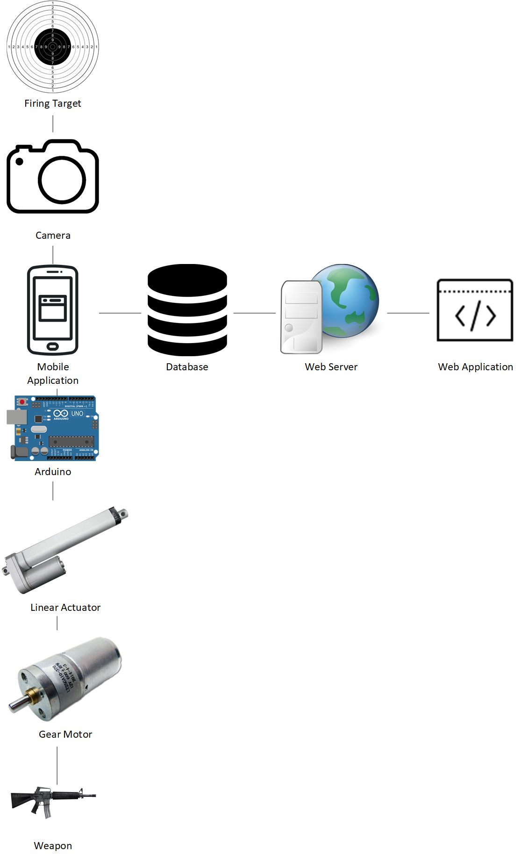
System Architecture

Slide 9
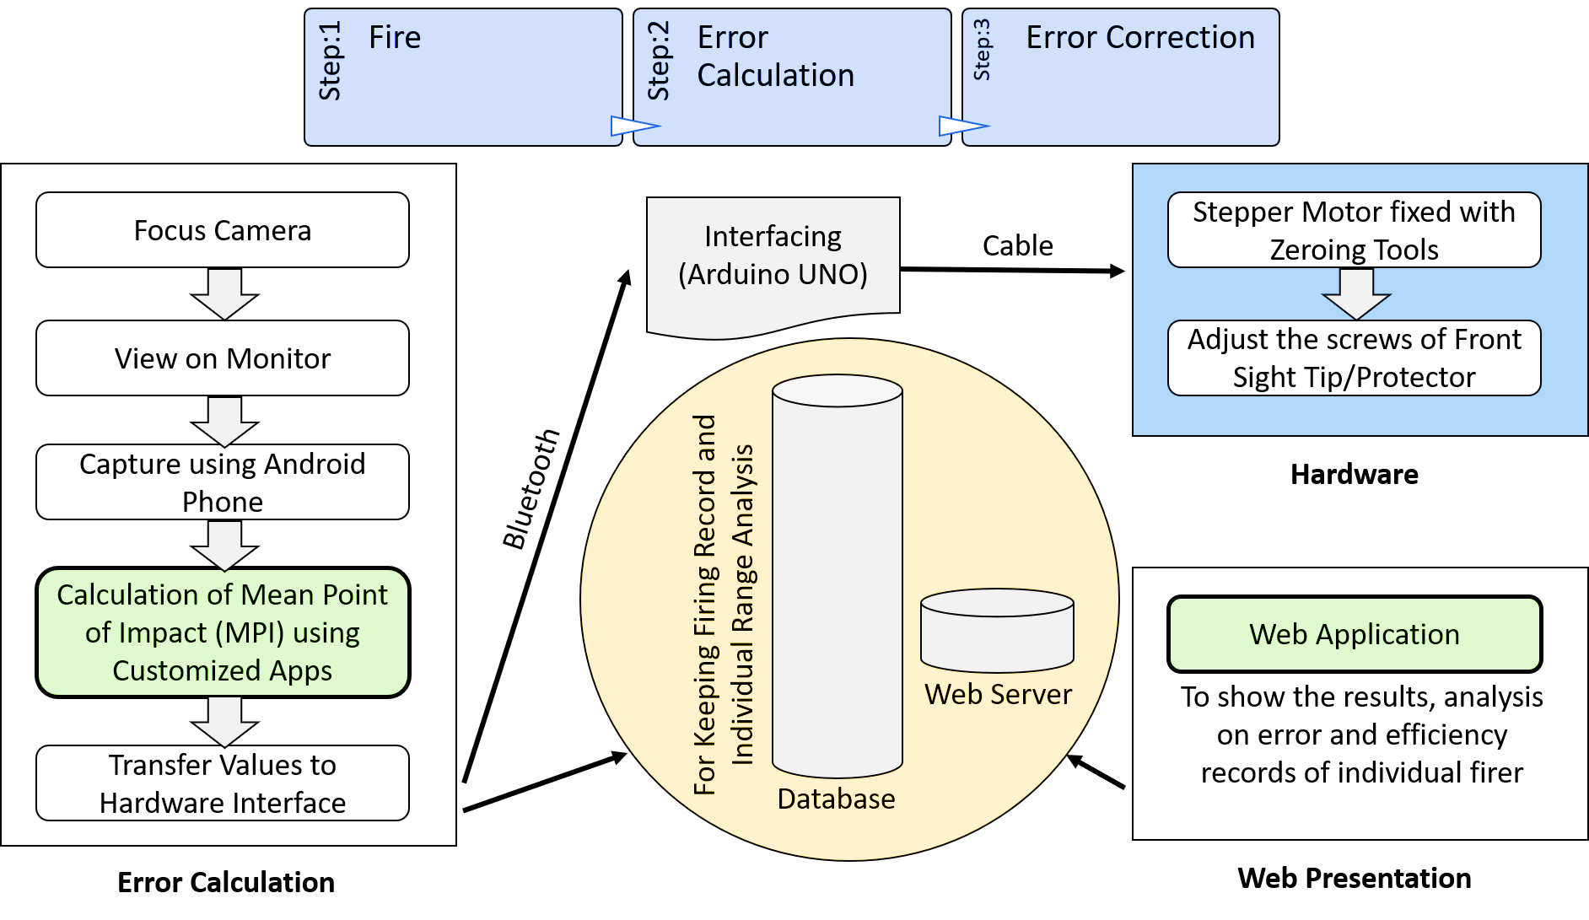
System Work Flow

Slide 10
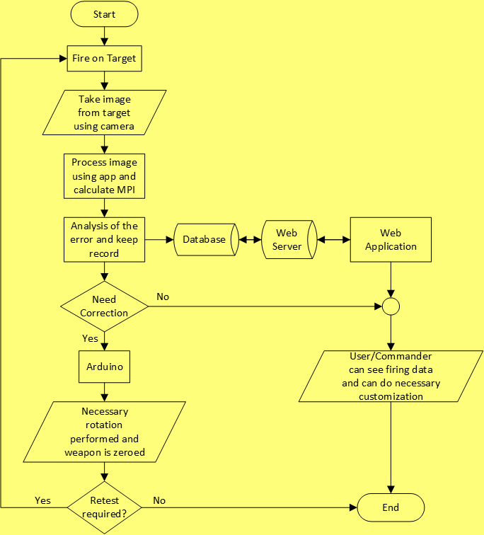
Work Flow Diagram

Slide 11
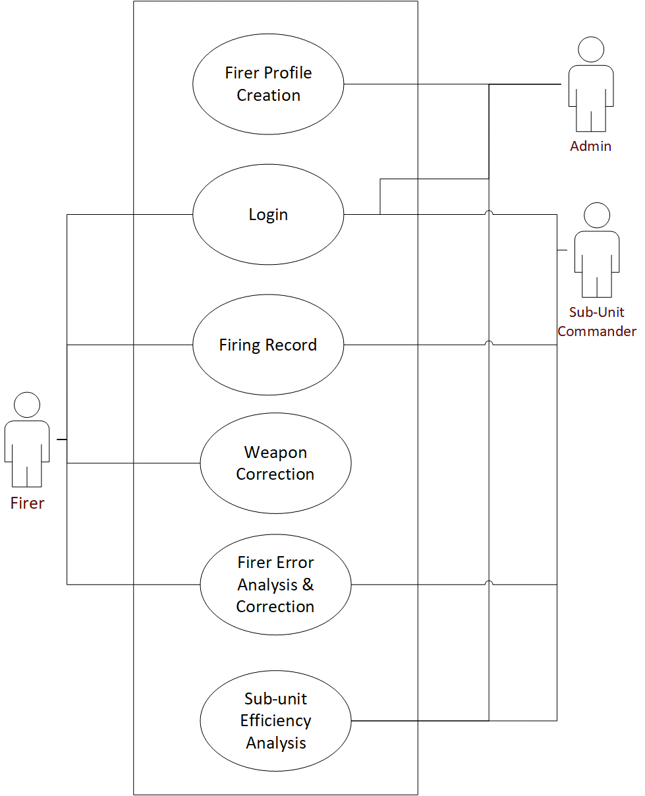
System Environment

Slide 12
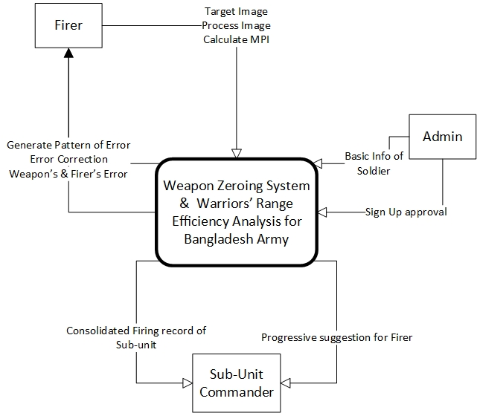
Context Diagram

Slide 13
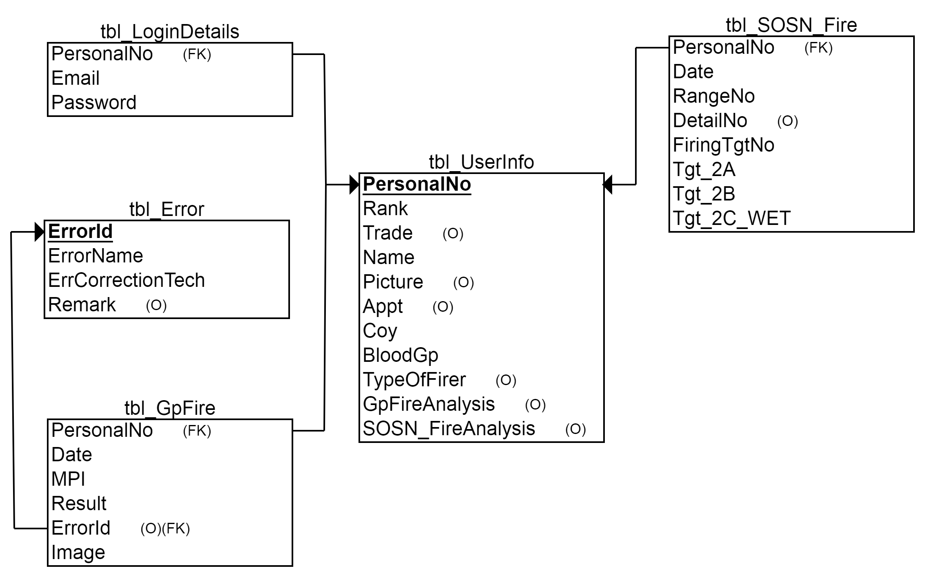
Schema Diagram

Slide 14
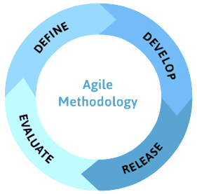
Project Approach

Slide 15
User Characteristics
Criteria | Firer | Sub-Unit Commander | Admin
Education Level | The ﬁrer has basic educational qualiﬁcation which is enough to use the system. | The person has enough educational qualiﬁcation to watch the system and the result, reports. | He must have high educational qualiﬁcations to maintain the system. Since the system will be under his control so he must have profound knowledge.
Experience | Basic Experience of firing | Not much required | Highly experienced to make and maintain system
Disabilities | - | - | -
Technical Expertise | Not much required | Not much required | Expert in programming and system development and maintenance

Slide 16
Work completion till date
Vertical correction of the front sight
Target image processing with inaccuracy
Mobile app to control the zeroing
Web app to monitor the system and result
Documentations

Slide 17
Project Milestone
Ser | Title | Forecast Date
1. | Completion of Idea Selection | 18-2-19
2. | Analysis Completion | 27-2-19
3. | Design Completion | 21-3-19
4. | Web and Android App Completion | 21-8-19
5. | Training Materials Completion | 22-9-19
6. | Documentation Completion | 29-9-19
7. | Deployment Completion | 16-10-19
8. | Project Completion | 24-10-19

Slide 18
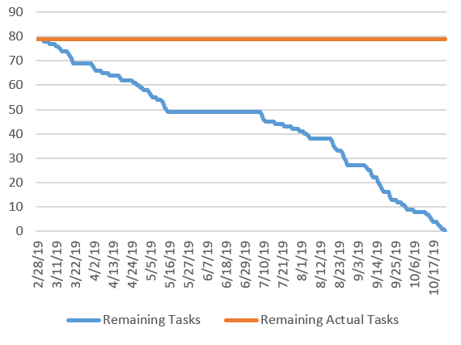
Milestone Report

Slide 19
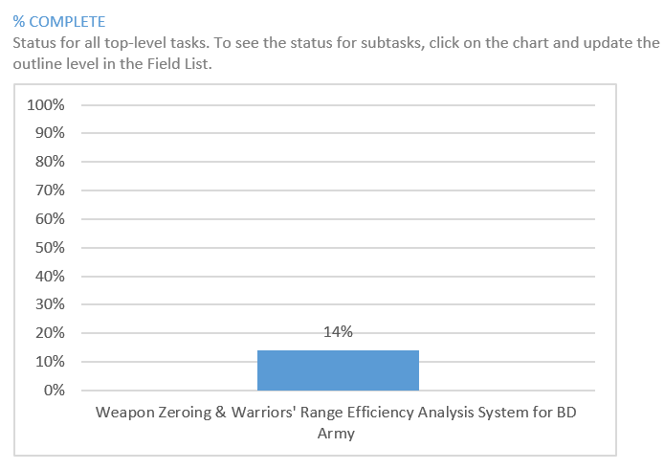
Percentage of Work Complete

Slide 20
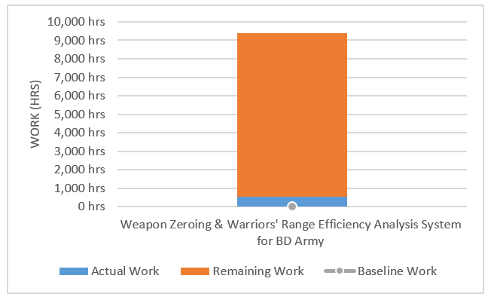
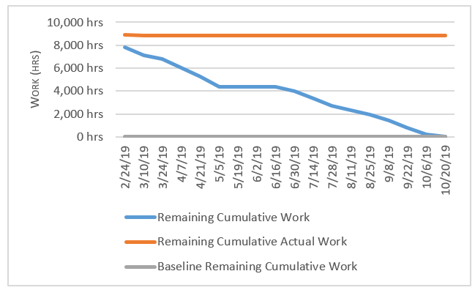
Work Overview

Slide 21
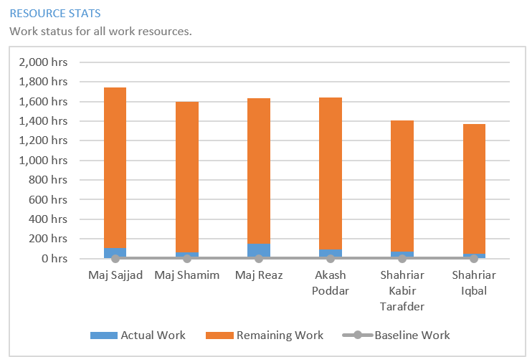
Resource Statistics

Slide 22
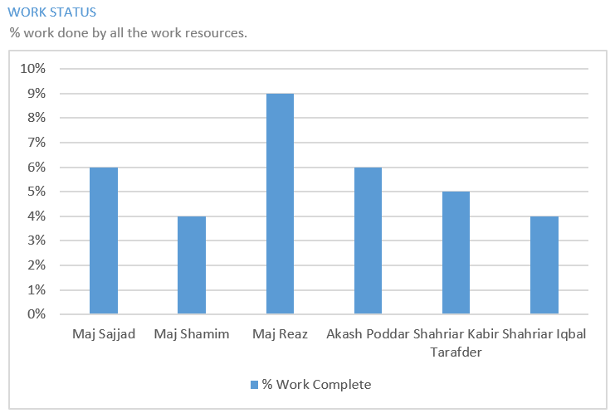
Work Status

Slide 23
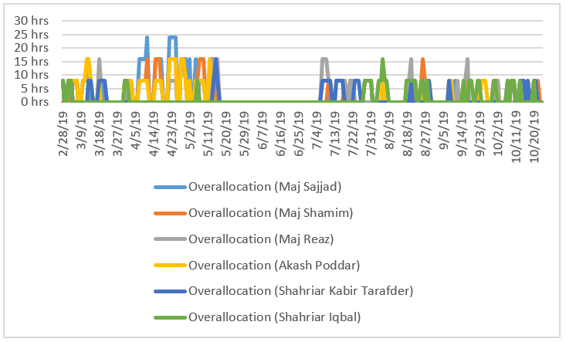
Resource Over allocation

Slide 24
Cost Estimate
Sr. No | Items | Cost (BDT)
1. | Cost of Equipment
 | Zeroing Tools | 4000.00
 | Gear Motor | 1000.00
 | Motor Driver | 400.00
 | High Volt Power Source | 500.00
 | Arduino Mega | 750.00
 | Linear Actuator | 3500.00
 | Prototype Metal Body Structure | 4000.00
 | Other hardware tools | 3000.00
2. | Conveyance
 | Transportation purpose | 2000.00
3. | Typing, Drafting, Binding and Paper etc. | 1500.00
Total Amount |  | 20,650.00

Slide 25
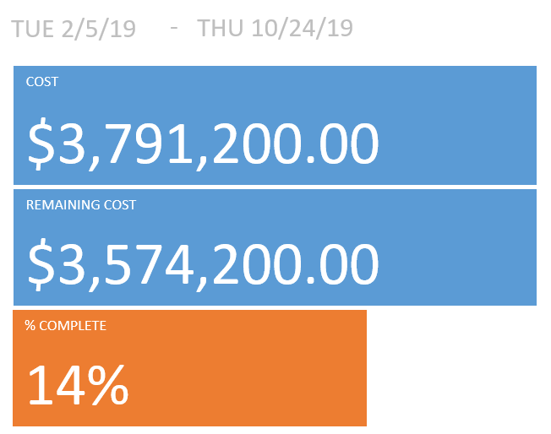
Cost Overview

Slide 26
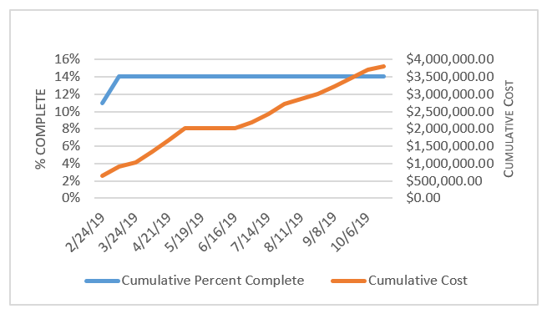
Progress versus Cost

Slide 27
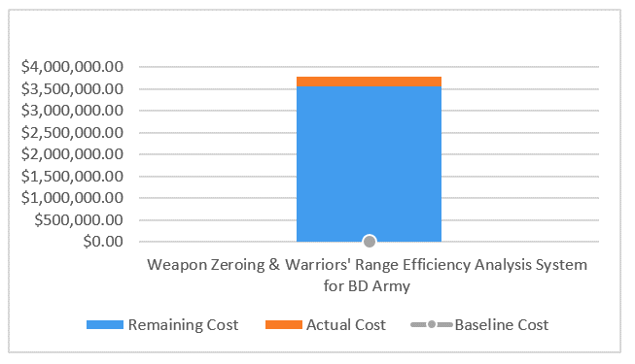
Cost Status

Slide 28
Mobile App UI

Slide 29


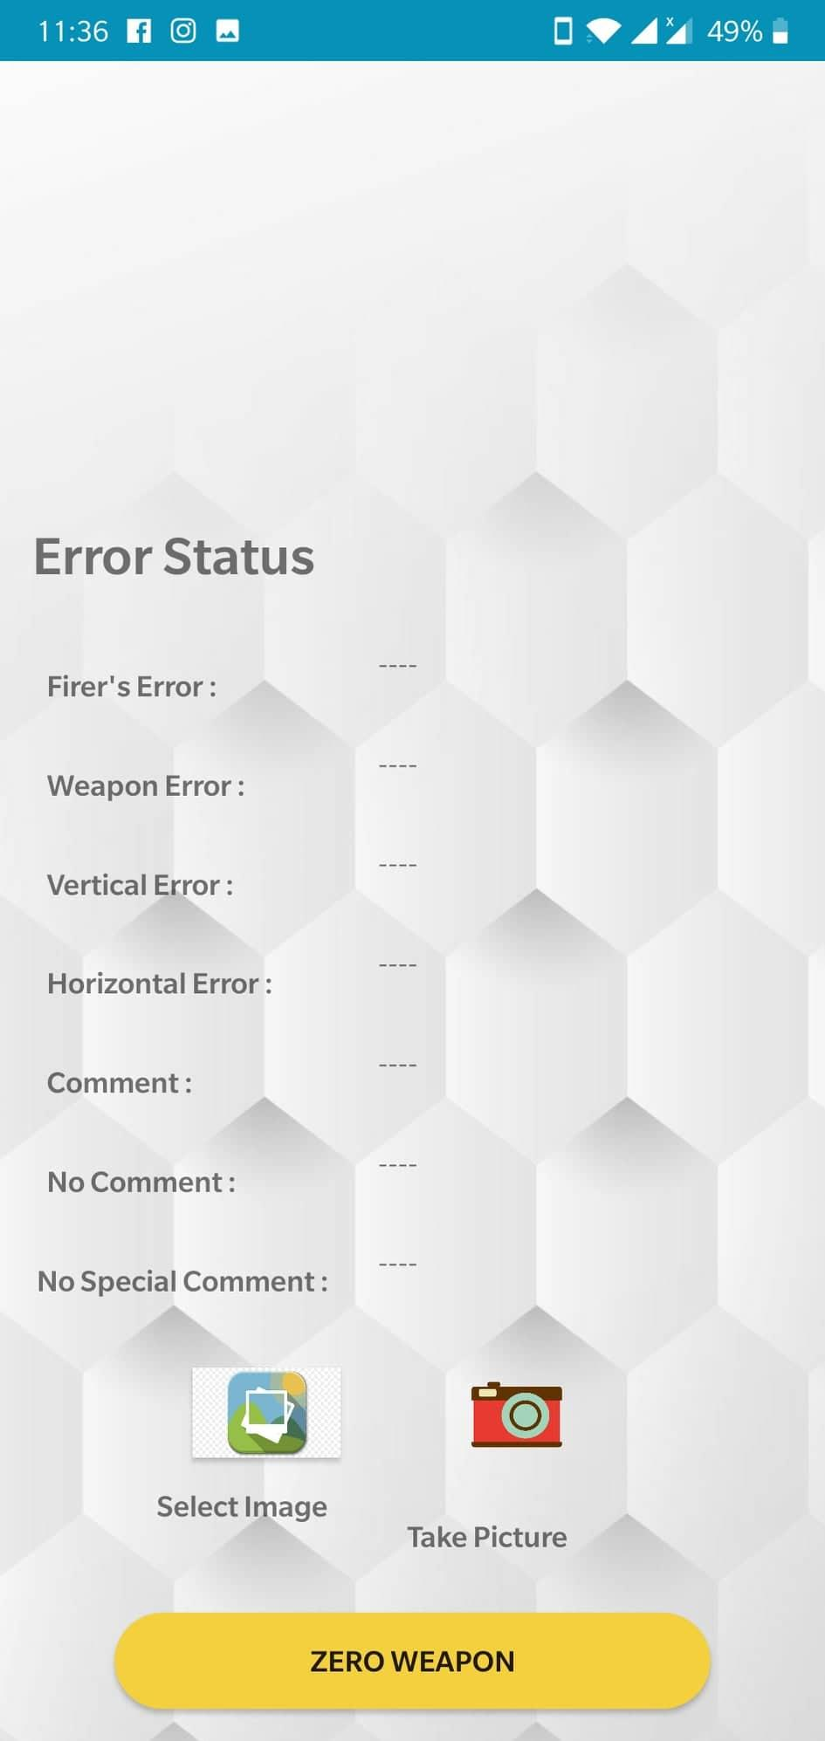

Slide 30
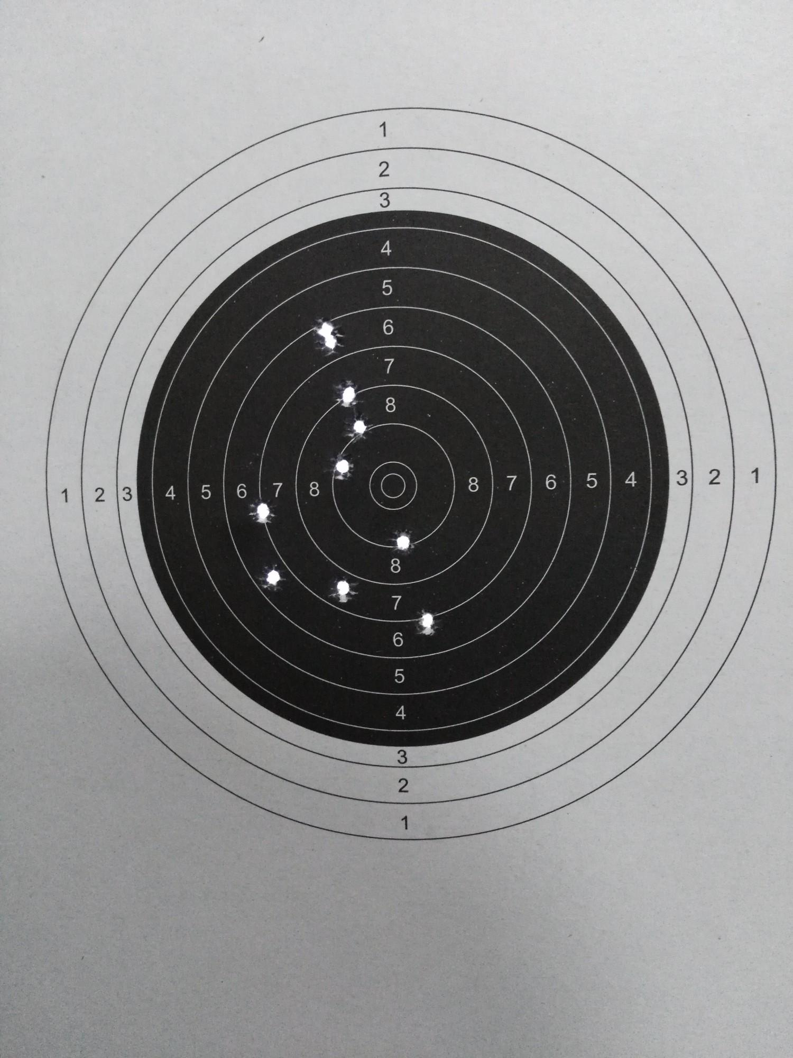
Target

Slide 31
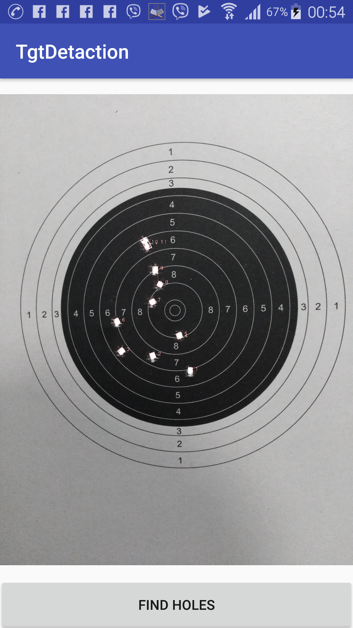
Target Detection

Slide 32
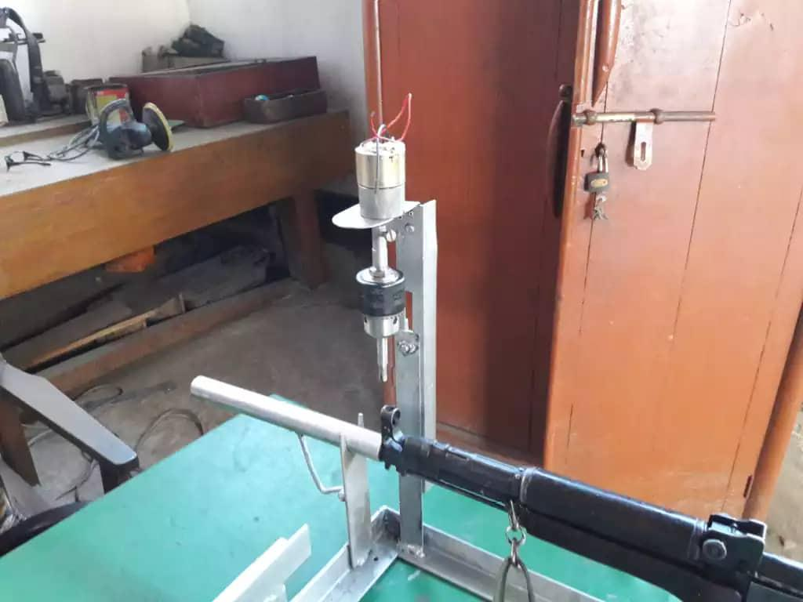
Hardware Front side Correction

Slide 33
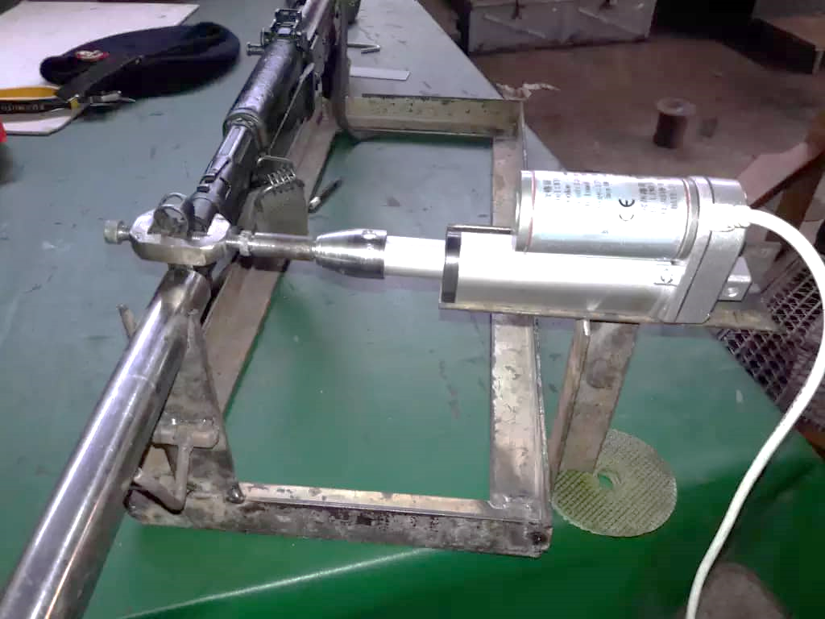
Hardware Lateral Correction (contd)

Slide 34
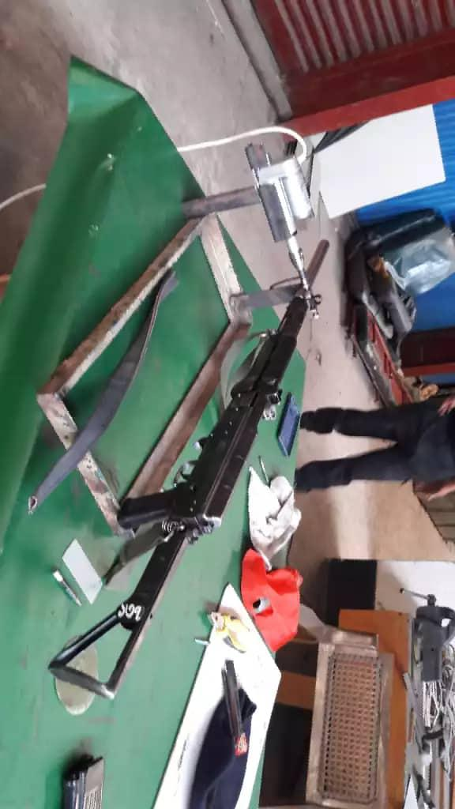
Hardware Lateral Correction (contd)

Slide 35
Limitations
Inaccurate target image processing
Unable to incorporate all types of firing like SOSN etc.
Random disruption in test and trial
Unable at acute zeroing

Slide 36
Future Expansion
Incorporate all types of firing
Accurate and precise target image processing
Auto crop of target image
Hardware conciseness
Determination of types of firer(human) error

Slide 37
Reference
N. Larsson and M. Petersen, “Mount for mounting accessories on a weapon,” Sep. 20 2011, uS Patent 8,020,335Database and Data-mining
R. L. Migliorini, “Thermal silhouette target and zeroing technique,” Jan. 8 2002, uS Patent 6,337,475
R. S. Randazzo and D. R. Brewer, “Scope mounting system,” Jul. 29 2003, uS Patent 6,598,333
G. R. O’brien and G. E. Bown, “Method for in-system auto zeroing of a torque sensor in an automatic transmission drive train,” May 1 2007, uS Patent 7,212,935.
J. P. Quinn, “Dual elevation weapon station and method of use,” Aug. 3 2004, uS Patent 6,769,347
G. A. Callegari, “Weapon benchrest,” Aug. 7 2001, uS Patent 6,269,578
C. Y. Devine, G. A. Shifrin, and R. W. Shoulberg, “Secure server architecture for web based data management,” Aug. 12 2003, uS Patent 6,606,708
H. S. Lambert and S. Wright, “Security mechanisms in a web server,” Mar. 26 2002, uS Patent 6,363,478
F. Patin, “An introduction to digital image processing,” online]: http://www. programmersheaven. com/articles/patin/ImageProc. pdf, 2003
R. J. Schalkoff, Digital image processing and computer vision. Wiley New York, 1989, vol. 286
D. E. Howard and F. J. Nola, “Stepper motor control that adjusts to motor loading,” Jan. 11 2000, uS Patent 6,013,999
M. Zribi and J. Chiasson, “Position control of a pm stepper motor by exact linearization,” IEEE Transactions on Automatic Control, vol. 36, no. 5, pp. 620–625, 1991.
C. O. Markkanen, D. B. Blackwell, G. A. Knaust, C. R. Kropac, and J. M. Mccall, “Stepper motor control system,” Jun. 22 1971, uS Patent 3,586,953
A. Danti, J. Y. Kulkarni, and P. Hiremath, “An image processing approach to detect lanes, pot holes and recognize road signs in indian roads,” International Journal of Modeling and Optimization, vol. 2, no. 6, p. 658, 2012.
A. G. Howard, M. Zhu, B. Chen, D. Kalenichenko, W. Wang, T. Weyand, M. Andreetto, and H. Adam, “Mobilenets: Efﬁcient convolutional neural networks for mobile vision applications,” arXiv preprint arXiv:1704.04861, 2017.

Slide 38

Query ?

Slide 39


Thank You!

